Slide 1

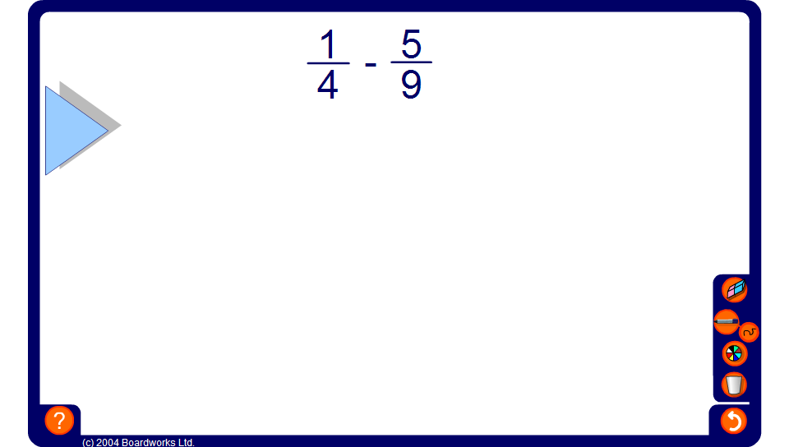


Adding and subtracting fractions
Notes:
Use this activity to talk through as many examples as necessary.

